Slide 1





Update Item Master

Slide 2
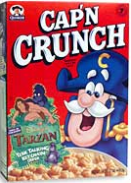
Product Information
Product Attributes
Customer/Manufacturing Specifications
Product Descriptions
Images
Multiple UPCs
Space Management Information
Containers
Inventory Sets
Taxation

Slide 3
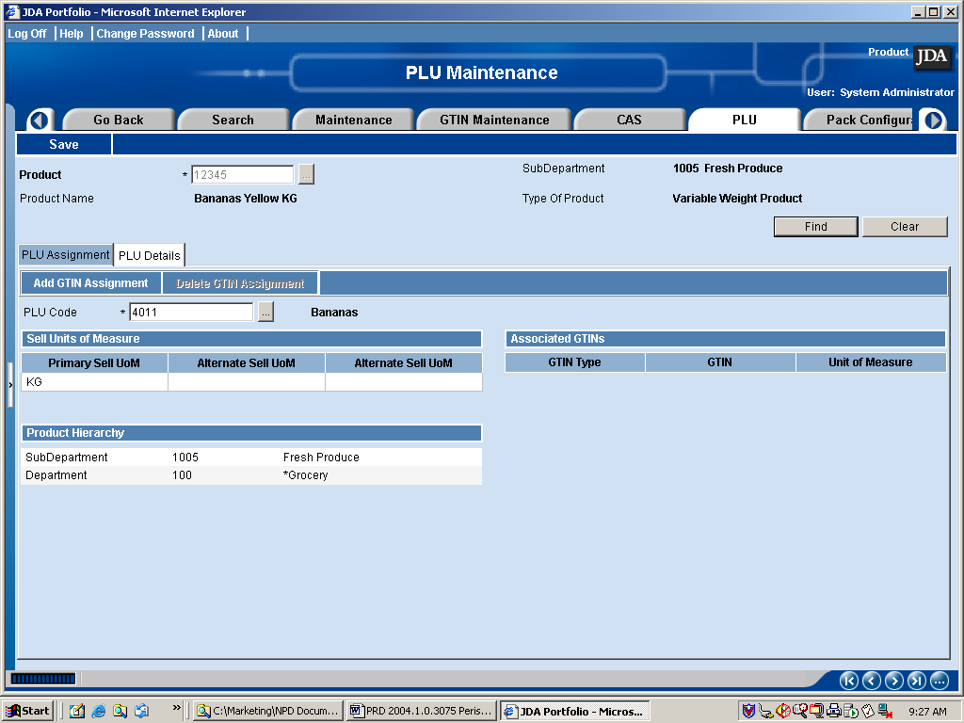
UPC/ PLU Assignment

Slide 4
Pricing Groups
Mix/Match Groups
    Products typically merchandised or promoted together
    Heinz Baby Food, Yogurt, etc
Deal Groups
    Products grouped together for promotional purposes.
    Coke & Hot Dog for $1.75
    Chips $ Salsa for $2.99

Slide 5
Sets
1. Prepack Set
  Dissimilar products sold together.
  Sale tracked by the Set
  Gift Basket, Dinnerware Set, Hamper, etc.
2. Break Set
  Similar Items; may be sold as a set or individually
  Carton of Cigarettes, 6 pack Code into Cans, etc.
3. Bill of Materials
  Track Cost/Margin of New Product
  Deplete Inventory of Components
  Deli Sandwich

Slide 6


Store and Product Attributes
Large Store
Outlet Store
Stand Alone Store
25,000-30,000 sq feet
Cold Climate
Age 30-40 years
Income 40-60k
Shelf Life 4-8 days
Expiration Date
Dairy Item
Vendor - Farm Fresh
Brand - Coca Cola
Shelf Tag Ticket

Slide 7

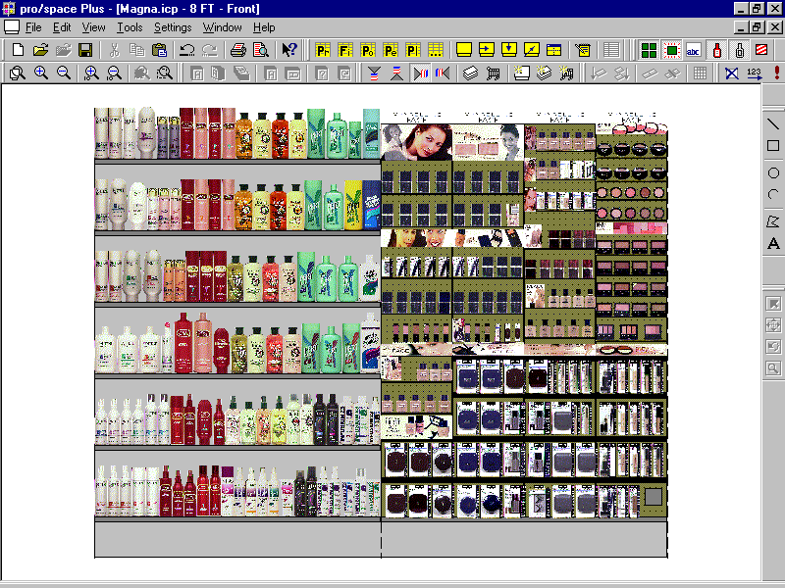
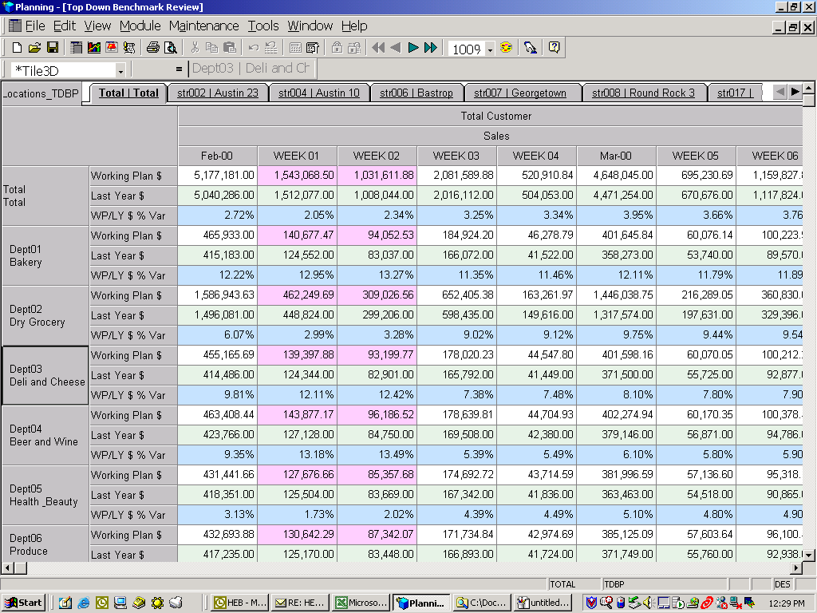
Assortment Management
Assortment Mgmt
Space Planning
Strategic Planning
POS / Backoffice
Portfolio
Merchandise
Management

Slide 8

Assortment Plans
Small
Frozen
Small
Format
Medium
Frozen
Medium
Dairy
Medium
Format
Medium
Produce
Medium
Grocery
Large
Format
Large
Frozen
Large
Meats

Slide 9
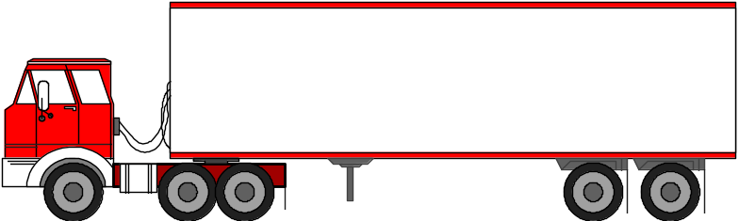
Vendor Management
Address
Contacts
Returns Parameters
Charges / Allowances
Atteributes
EDI Transactions
Notes
Ship Points
PO Defaults
    Payment Terms
    Shipping Terms
    Lead Time…

Slide 10
Update Item Master

